Slide 1
Lending Club Case Study
Presenters:
Kallal Nath
Priyadharshini V

Slide 2
Business Problem Statement
The company Lending Club is the largest online loan marketplace, facilitating personal loans, business loans, and financing of medical procedures.
Typically, as a lending company, Lending Club also runs the risk of having bad customers in its portfolio who eventually end up being defaulters to their loan.
Lending loans to ‘risky’ applicants is the largest source of financial loss (called credit loss). Credit loss is the amount of money lost by the lender when the borrower refuses to pay or runs away with the money owed.
Such defaulting of loan imparts a huge financial dent in the books of the lending company.

Slide 3
Case Study Objective
The Objective of this case study is to apply Exploratory Data Analysis techniques on a real-world problem faced by financial companies and understand the insights and present the key outcomes via this presentation.
Expected outcome from the case study:
Identify variables which are potential indicators of loan defaulters and hence contribute towards reducing credit loss of Lending Company
Share key observations around range of customer attributes and loan attributes which can add as useful insights for business.
Business Benefits:
Lending Company gets a working strategy to efficiently handle prospective customers or applicants of loan and thereby takes the right and effective decision on whether to reject or approve based on certain variables.
Embracing the outcomes will enable business to take data-driven decisions such as rejecting a loan, reducing the amount of loan, lending (to risky applicants) at a higher interest rate, etc.

Slide 4
Analysis Approach
Documents and Artefacts provided for analysis:
Loan Dataset containing loan and customer related information about past loan applicants (2007-2011) and whether they defaulted or not. Dataset has details regarding approved loan not the rejected ones. It has 3 statuses of loan which is Fully Paid, Current and Charged-Off. It has 100+ attributes
Data Dictionary explaining the definition and business context of each field in the dataset
The dataset is cleaned first followed by Univariate, Segmented Univariate & Bivariate Analysis
Data Clean-up and preparation process:
Importing the Data
Removing large null value columns
Removing irrelevant columns
Removing/Fixing null values
Correcting data types and deriving new columns
Filter Data for requirement.
Removing Duplicate Data
Removing outliers

Slide 5
Data Exploration and Data Cleaning
The following techniques were used broadly to explore the dataset and do the necessary cleaning before it is ready for analysis.
Removing & Fixing Missing values in Columns
Removing & Fixing Missing values in Rows
Check for and delete unnecessary columns and rows which will hold no significance to our analysis
Standardizing values like removal of ‘%’, formatting of variables
Correcting Data Types and Deriving New Columns – Date Driven Metrics like extracting Month & Year from Date variable
Identifying and removing outliers unless not impacting the analysis

Slide 6
Univariate Analysis
Observations in univariate analysis are not closely related to our objective. Presenting the facts derived out of the analysis-
Around 14% of the borrowers during the period 2007 – 2011 turned out to be defaulters.
Borrowers frequently opt for loan between 5%-7% and 10% -15% interest rate
More than 50% of the loans granted in 5 years were with high grade ‘A’, ‘B’ and ‘C’.
Borrowers in rental house or mortgaged house are more interested in acquiring a loan.
Majority of the borrowers have no record of Public Recorded Bankruptcy.
Majority of the borrowers have very large debt compared to their income, concentrated mostly in the 10-20 DTI ratio.
Majority of borrowers have fairly low annual income as compared to rest who are less in numbers.
Majority of the loans were taken for debt consolidation followed by credit card. Such borrowers already have running debt to cover. And they take further loan to pay for their credit card outstanding.

Slide 7
Segmented Univariate Analysis

Slide 8
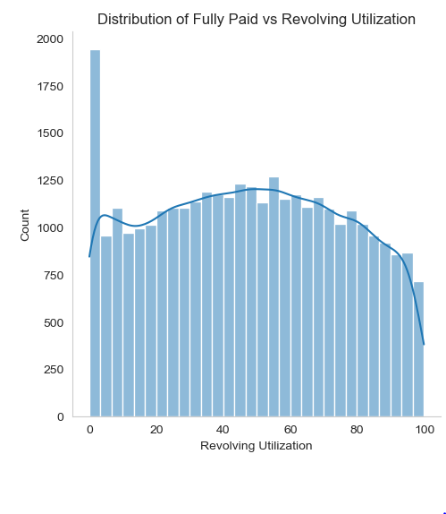
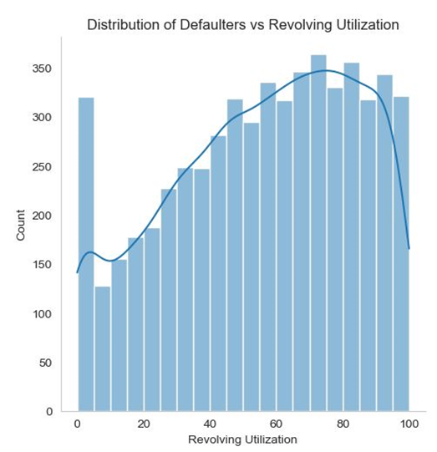
Revolving Utilisation
Fully paid customers maintain lesser revolving utilisation
Defaulters are more likely to have more than 50% of revolving utilization.

Slide 9
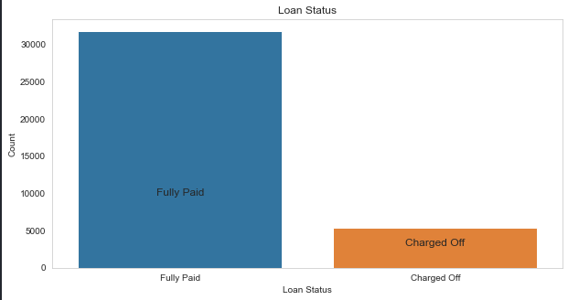
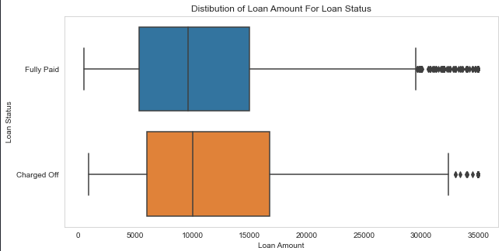
Loan Status and Amount
Loan Status: The proportion of charged off loan is much smaller(14.5%) compared to total count.
Loan Amount: It varies from 500 to 35000 with a median of 10000. Loan amount is majorly small and very few borrowers took large loans and larger it goes there is higher chance of defaulting.

Slide 10
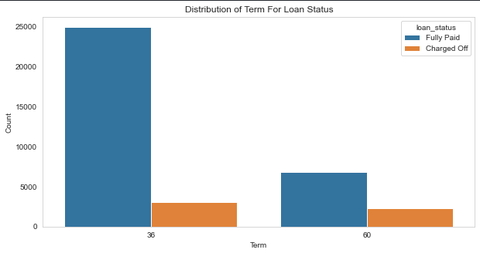
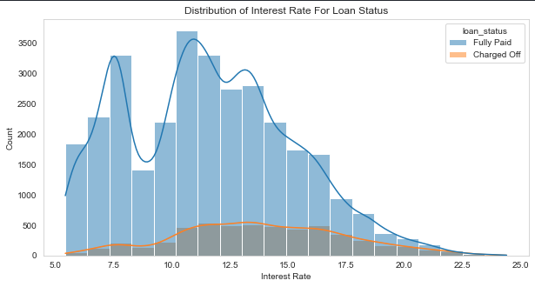
Term and Interest Rate
Loan Term: The Loans taken for 36 month term are much more than 60 months and have lower chance of defaulting.
Interest Rate: The count of loan taken varies with interest rate showing peak around in 5-15 bracket and decreasing slowly where as the chance of defaulting increases with interest rate.

Slide 11
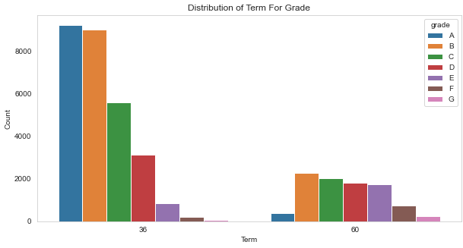
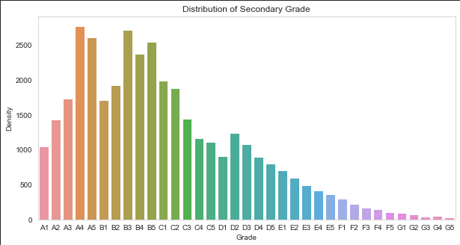
Grade and Sub-Grade
Grade: The loan approved are majorly of higher grade as they are of low risk thus low chance of defaulting. 60 month term loans have larger number of lower grade loans with high risk.
Sub Grade: This provides more insight that the loans within grade are more skewed towards lowered sub grades.

Slide 12
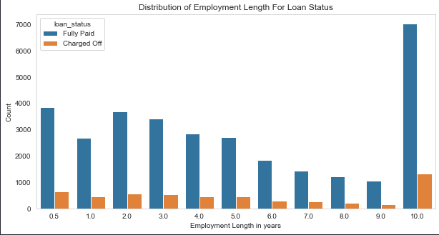
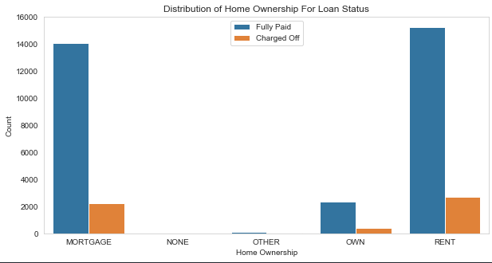
Employment Length & Homeownership
Employment Length: Majority of clients have 10+ years of experience and has highest number of defaulted loan.
Home Ownership: Majority of clients are lacking ownership of any property and are on rent or mortgage and have a higher chance of defaulting.

Slide 13
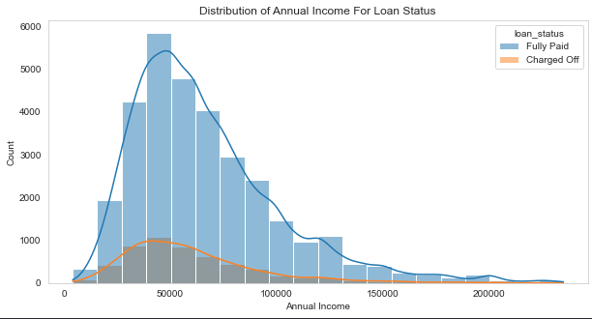
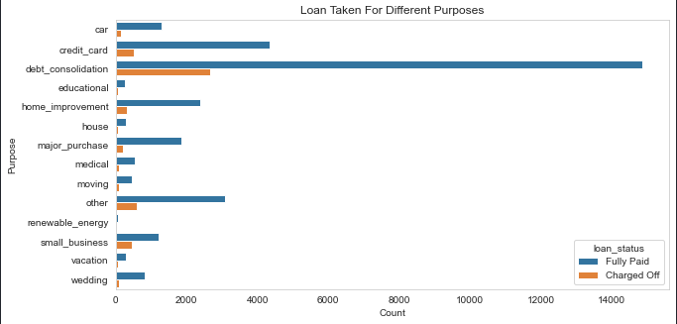
Annual Income & Purpose
Annual Income : Majority of borrowers have low annual income compared to rest and income lower than 50k has higher chance of defaulting.
Purpose: Loans are taken mostly for debt consolidation followed by credit card payment. Whereas the debt consolidation has highest fully paid loan but also has highest defaulted loans as well.

Slide 14
Bivariate Analysis

Slide 15
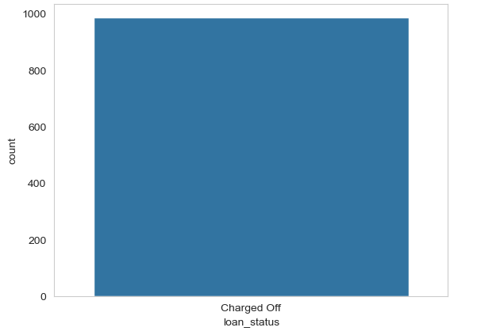
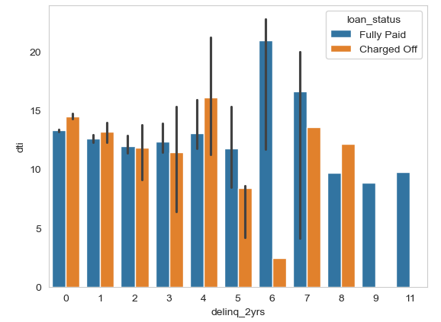
Total Interest and Principal paid DTI & Delinquency
Borrowers who paid interest exceeding principal amount are 100 % defaulters
More than 12 DTI have higher chances for default. Delinquency have a very weak connection in judging defaulters

Slide 16
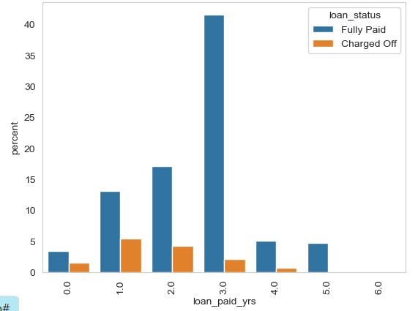
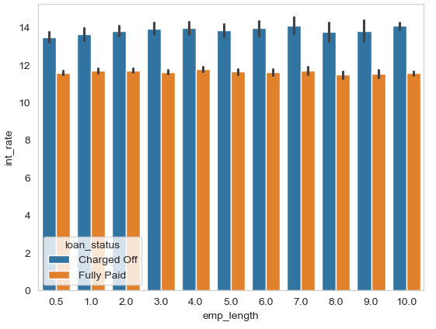
Loan paid duration DTI & Delinquency
Loan duration of less than 3 years have high chance for defaulting
More than 12% interest rate are 100% defaulters

Slide 17
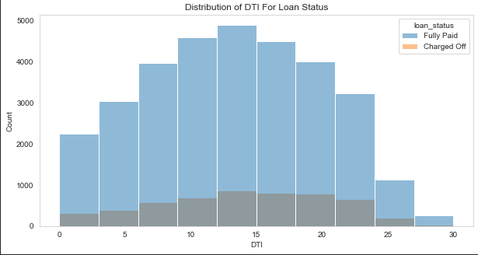
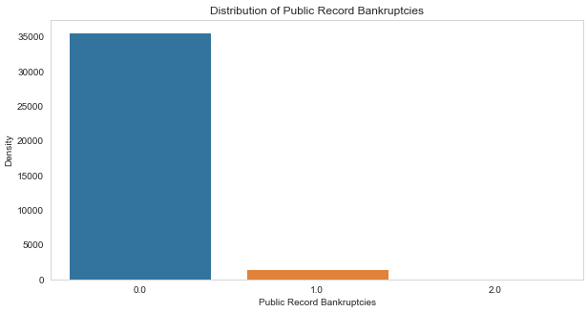
DTI ratio & Bankruptcy
DTI: The large percentage of Clients have a large Debt to Income ratio which shows that lending to such clients can be very risky.
Public Recorded Bankruptcy: Majority of clients have no record of declaring bankruptcy.

Slide 18
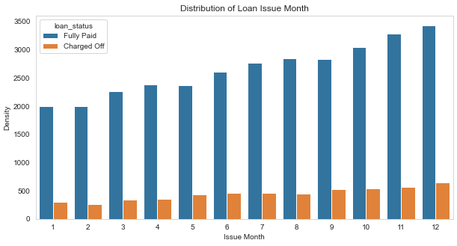
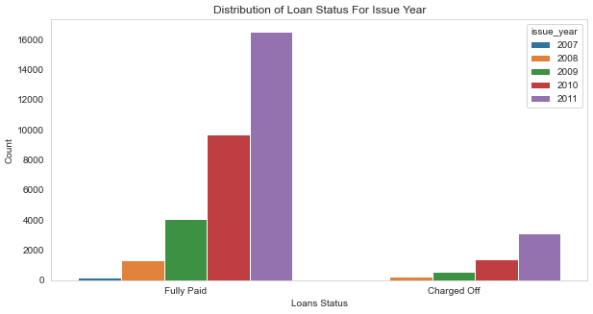
Loan Trend over years
We see a gradual increase in loan taken through the year, with lesser defaulting rate in April ,August, December quarter wise and better more late in year.
With each passing year loan taken are increasing exponentially which indicate we are seeing large increase in DTI ratio and decrease in defaulting rate.

Slide 19
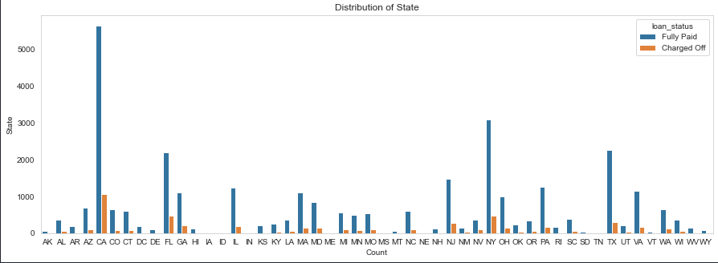
Location Based
For large metropolitan cities we see large number of loans, with higher number of defaulted loans like California, New York, Texas, Florida but have a lower chance of defaulting.

Slide 20
Recommendations - Driving factors
Major Driving factor which can be used to predict the chance of defaulting and hence avoiding Credit Loss:
1. DTI
2. Grades
3. Verification Status
4. Annual income
5. Pub_rec_bankruptcies
6. Interest rate
7. Purpose

Slide 21
Recommendations - Checkpoints for Defaulters
1. From large urban cities like California, New York, Texas, Florida etc.
2. Annual income in the range 50000-100000.
3. Borrowers having Public Recorded Bankruptcy.
4. Borrowers with least sub grades like E,F,G which indicates high risk.
5. Loan purpose is debt consolidation or credit card.
6. Borrowers having working experience of more than 10 years.
7. Borrowers with Debt-to-Income ratio greater than 13
8. Interest rate higher than 12
9. Paid interest exceeding paid principle
10.Revolving Utilization is more than 50%
11.Loan repayment duration is less than 3 years

